Slide 1

GAIA knockoff Logic WorkFlow
By Hemanto Bairagi

Slide 2

Workflow Logic by Feature
3 major features:
On-road routing
Off-road routing
Satellite Tracking of location

Slide 3
On-road routing : Workflow Logic by Feature
On-Road Routing:
Designed to take data and produce on-road route instructions per user specification
Logic design given in Gaia_knock_off/Logic_and_Design.txt
Back End Pythonic API accepts data
User data fed into Google Maps API
on_road.py API produces user required data as JSON output
Front End GUI takes output from Pythonic API and serves the JSON output to the User (route data)
Front End GUI takes input from user (location data)
REST API
REST API

Slide 4
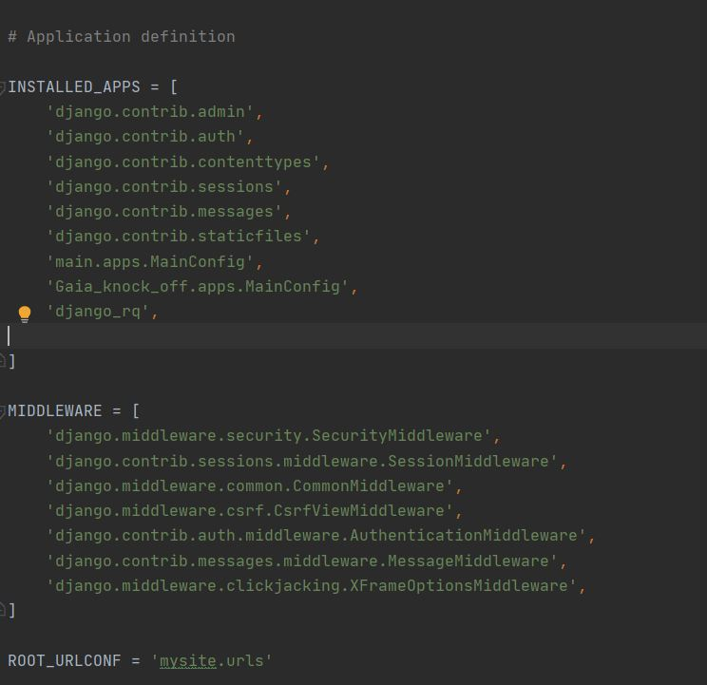
Specifics of ON-Road pythonic api
User data entered from GUI into a Django ORM database and then passed to the onroad.py API from the Rest API.
Onroad.py API contains pythonic methods that process data into finished requested output
Data passed back to Django framework from sub application via Middleware, so output data can be formatted into JSON data
Json Data passed back to Rest API which passes user solution to the GUI per user specification.
Any Modification can be used implemented via GIT version control moving forward.

Slide 5
OFF-road routing : Workflow Logic by Feature
Off-Road Routing:
Designed to take data and produce on-road route instructions per user specification
Logic design given in Gaia_knock_off/Logic_and_Design.txt
Back End Pythonic API accepts data
User data fed into Google Maps API
off_road.py API produces user required data as JSON output
Front End GUI takes output from Pythonic API and serves the JSON output to the User (route data)
Front End GUI takes input from user (location data)
REST API
REST API

Slide 6
Specifics of OFF-Road pythonic api
User data entered from GUI into a Django ORM database and then passed to the offroad.py API from the Rest API.
Rest API interacts with the Django framework and user data passed to backend pythonic off_road.py API via middleware as shown above.
Location data generates a PBF.OSM file
This file is then processed via methods with the API to generate an offroad route using: https://denikozub.github.io/Offroad-routing-engine/#installation with examples shown here: https://github.com/Denikozub/Offroad-routing-engine/blob/main/docs/usage.ipynb
This route can then be given back to the user via JSON once the pythonic API offloads data back to the Django framework once data processing has been completed
JSON output served to rest API and client as specified

Slide 7
Specifics of Satellite Tracking pythonic api
Satellites tracking algorithm

Slide 8
Architecture
sd

Slide 9
maintenance and cloud if deployed
sd

